Slide 1
Chapter 5: Implementing Intrusion Prevention
CCNA Security v2.0

Slide 2
Chapter Outline
5.0 Introduction
5.1 IPS Technologies
5.2 IPS Signatures
5.3 Implement IPS
5.4 Summary

Slide 3
Section 5.1: IPS Technologies
Upon completion of this section, you should be able to:
Explain zero-day attacks.
Understand how to monitor, detect and stop attacks.
Describe the advantages and disadvantages of IDS and IPS.

Slide 4
Topic 5.1.1: IDS and IPS Characteristics

Slide 5
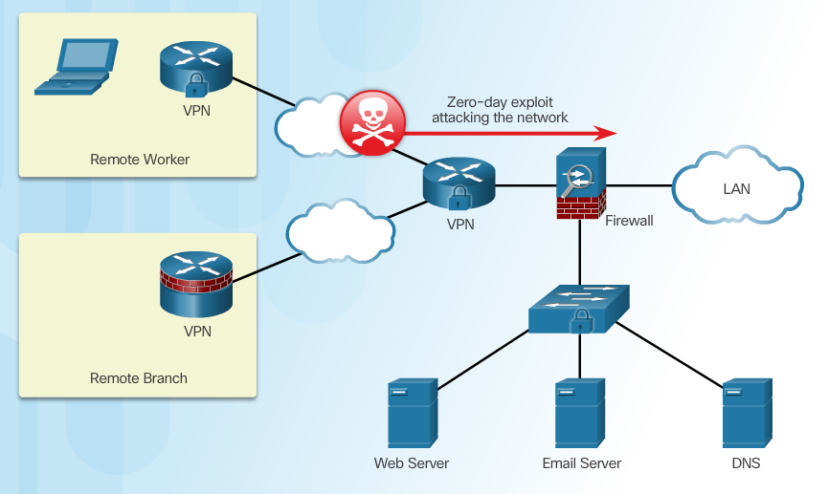
Zero-Day Attacks
Notes:
5.1.1.1 Zero Day Attacks

Slide 6
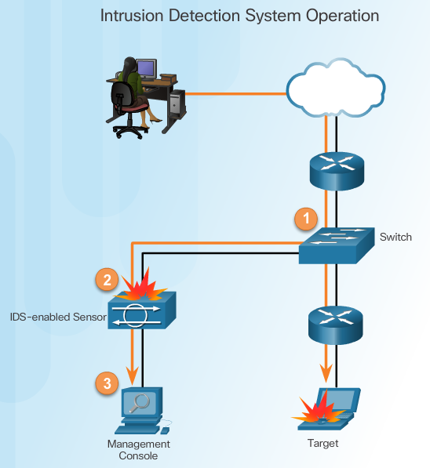
Monitor for Attacks
Advantages of an IDS:
Works passively
Requires traffic to be mirrored in order to reach it
Network traffic does not pass through the IDS unless it is mirrored
Notes:
5.1.1.2 Monitor for Attacks

Slide 7
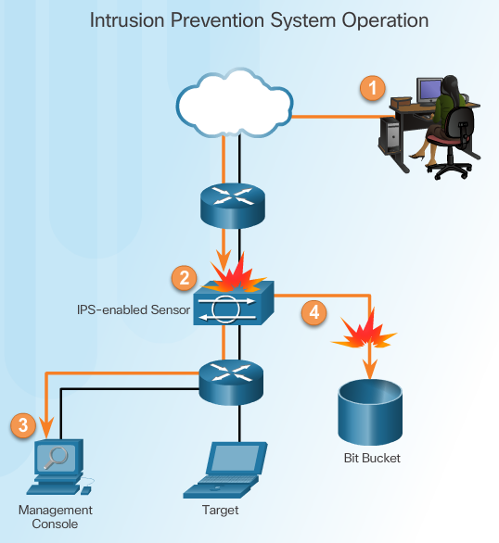
Detect and Stop Attacks
IPS:
Implemented in an inline mode
Monitors Layer 3 and Layer 4 traffic
Can stop single packet attacks from reaching target
Responds immediately, not allowing any malicious traffic to pass
Notes:
5.1.1.3 Detect and Stop Attacks

Slide 8
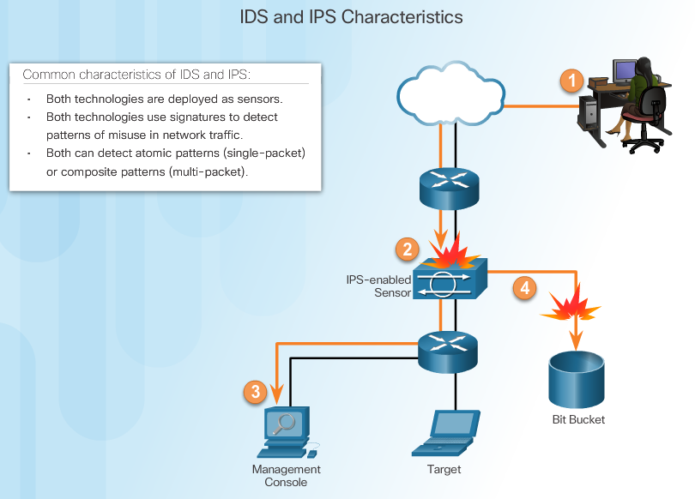
Similarities Between IDS and IPS
Notes:
5.1.1.4 Similarities Between IDS and IPS

Slide 9
Advantages and Disadvantages of IDS and IPS
Advantages IDS:
No impact on network
No network impact if there is a sensor failure
No network impact if there is a sensor overload
Advantages IPS:
Stops trigger packets
Can use stream normalization techniques
Disadvantages IDS:
Response action cannot stop trigger
Correct tuning required for response actions
More vulnerable to network security evasion techniques
Disadvantages IPS:
Sensor issues might affect network traffic
Sensor overloading impacts the network
Some impact on network
Notes:
5.1.1.5 Advantages and Disadvantages of IDS and IPS

Slide 10
Topic 5.1.3: Cisco Switched Port Analyzer

Slide 11
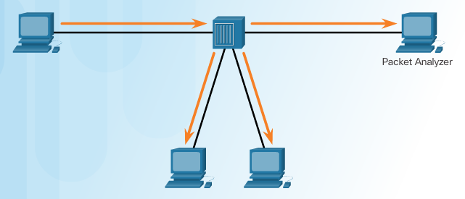
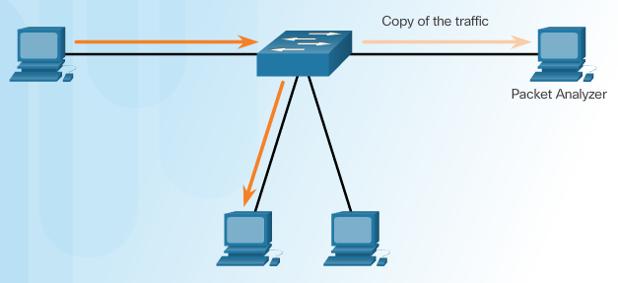
Port Mirroring
Traffic Sniffing Using a Hub
Traffic Sniffing Using a Switch
Notes:
5.1.3.1 Port Mirroring

Slide 12
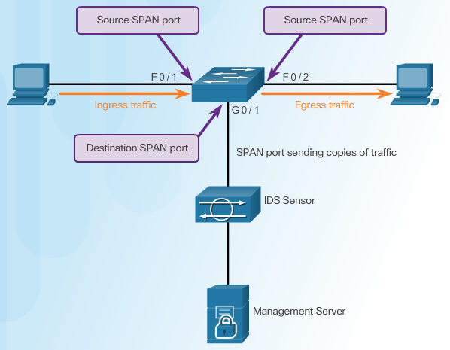
Cisco SPAN
Notes:
5.1.3.2 Cisco SPAN

Slide 13


Configuring Cisco SPAN Using Intrusion Detection
Cisco SPAN Commands:
Monitor session command – used to associate a source port and a destination port with a SPAN session.
Show monitor command – used to verify the SPAN session.
monitor session 1 source interface Gi1/0/2
monitor session 1 destination interface Gi1/0/1
Wireshark filter
ip.dst == 172.17.12.142 and ip.src == 172.17.12.143
Notes:
5.1.3.3 Configuring Cisco SPAN Using Intrusion Detection

Slide 14
Section 5.2: IPS Signatures
Upon completion of the section, you should be able to:
Understand IPS signature characteristics
Explain IPS signature alarms
Manage and monitor IPS
Understand the global correlation of Cisco IPS devices

Slide 15
Signature Attributes
A signature is a set of rules that an IDS and an IPS use to detect typical intrusion activity.
Signatures have three distinct attributes:
Type (atomic, composite)
Trigger – alarm (pattern-based, anomaly-based, policy-based, honey pot-based)
Action (generate alert, logging, resetting TCP connection, block future activity, allow activity )
Notes:
5.2.1.1 Signature Attributes

Slide 16
Signature Types
Signatures are categorized as either:
Atomic – this simplest type of signature consists of a single packet, activity, or event that is examined to determine if it matches a configured signature. If yes, an alarm is triggered and a signature action is performed.
Composite – this type of signature identifies a sequence of operations distributed across multiple hosts over an arbitrary period of time.
Notes:
5.2.1.2 Signature Types

Slide 17
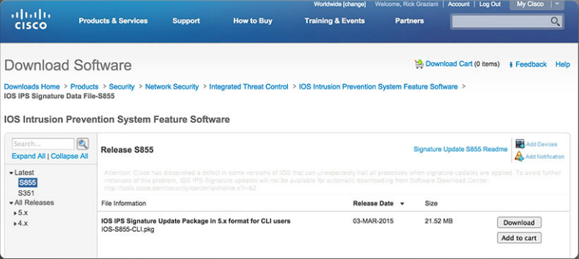
Signature File
As new threats are identified, new signatures must be created and uploaded to an IPS.
A signature file contains a package of network signatures.
Notes:
5.2.1.3 Signature File

Slide 18
Signature Micro-Engines
Cisco IOS defines five micro-engines:
Atomic – Signatures that examine simple packets.
Service – Signatures that examine the many services that are attacked.
String - Signatures that use regular expression-based patterns to detect intrusions.
Multi-string – Supports flexible pattern matching and Trend Labs signatures.
Other – Internal engine that handles miscellaneous signatures.
Notes:
5.2.1.4 Signature Micro-Engines

Slide 19
Topic 5.2.2: IPS Signature Alarms

Slide 20
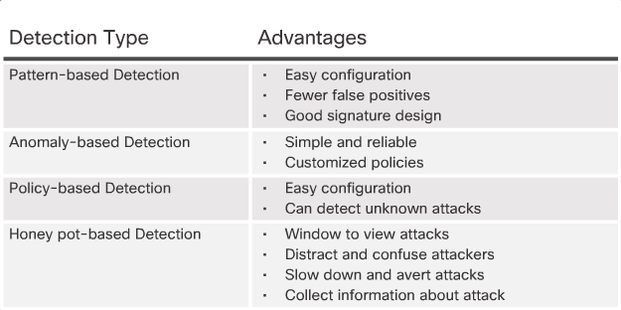
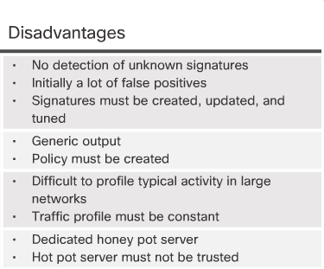
Signature Trigger (Alarm)
Notes:
5.2.2.1 Signature Alarm

Slide 21
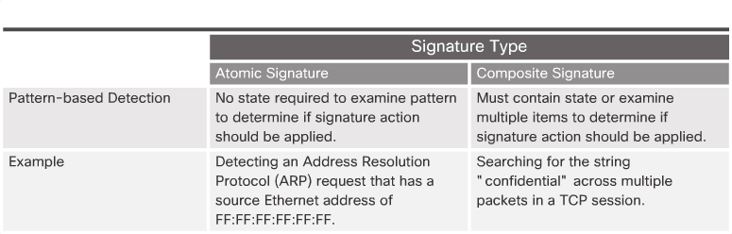
Pattern-Based Detection
Notes:
5.2.2.2 Pattern-Based Detection

Slide 22
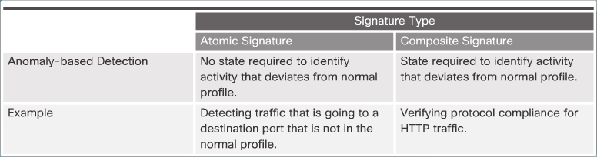
Anomaly-Based Detection
Notes:
5.2.2.3 Anomaly-Based Detection

Slide 23
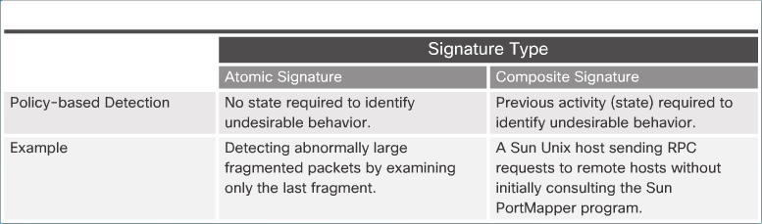
Policy-Based and Honey Pot-Based Detection
Notes:
5.2.2.4 Policy-Based and Honey Pot-Based Detection

Slide 24
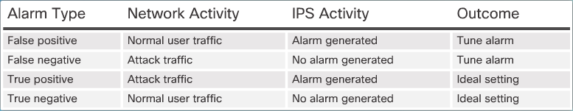
Alarm Triggering Mechanisms
Understanding Alarm Types:
Notes:
5.2.2.6 Alarm Triggering Mechanisms
5.2.2.7 Activity – IPS Signature Alarms

Slide 25
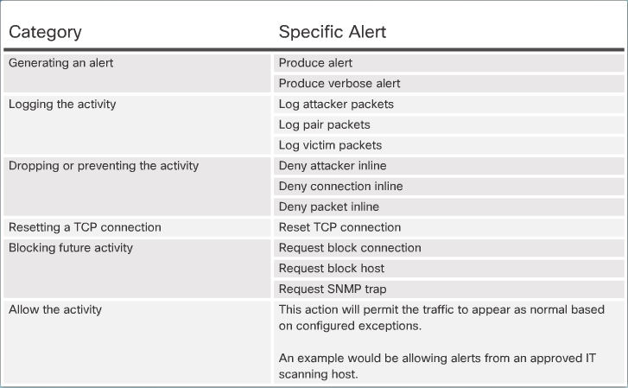
Signature Actions
Summary of Action Categories:
Notes:
5.2.3.1 Signature Actions

Slide 26
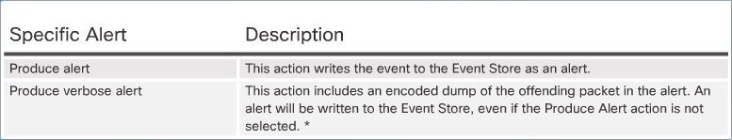
Manage Generated Alerts
Generating an Alert:
Notes:
5.2.3.2 Manage Generated Alerts

Slide 27
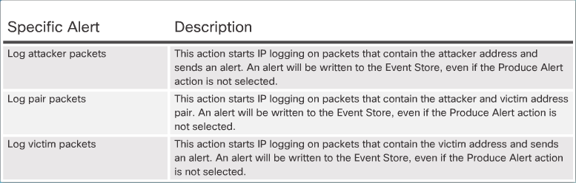
Log Activities for Later Analysis
Logging the Activity:
Notes:
5.2.3.3 Log Activities for Later Analysis

Slide 28
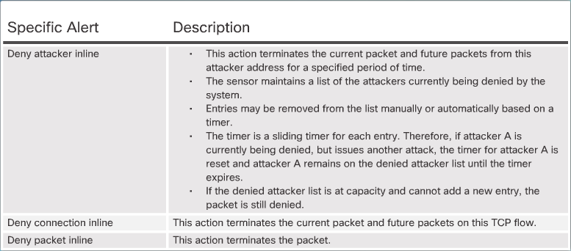
Deny the Activity
Dropping or Preventing the Activity:
Notes:
5.2.3.4 Deny the Activity

Slide 29
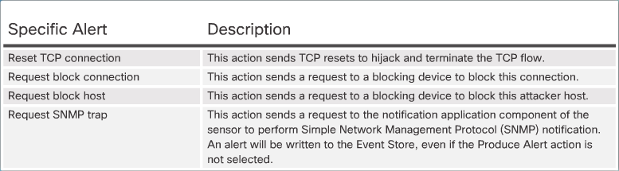
Reset, Block, and Allow Traffic
Resetting the Connection and Blocking the Activity:
Notes:
5.2.3.5 Reset, Block, and Allow Traffic
5.2.3.6 Activity – Identify the IPS Signature Action

Slide 30
Section 5.3: Implement IPS
Upon completion of this section, you should be able to:
Understand how to configure Cisco IOS IPS with CLI
Explain how to verify and monitor IPS

Slide 31
Topic 5.3.1: Configure Cisco IOS IPS with CLI

Slide 32
Implement IOS IPS
Step 1. Download the IOS IPS files.
Step 2. Create an IOS IPS configuration directory in Flash.
Step 3. Configure an IOS IPS crypto key.
Step 4. Enable IOS IPS.
Step 5. Load the IOS IPS signature package to the router.
Notes:
5.3.1.1 Implement IOS IPS

Slide 33
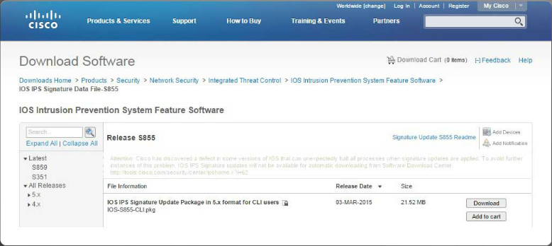
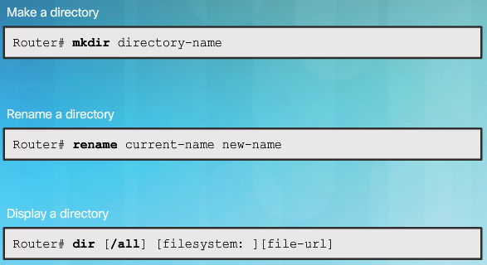
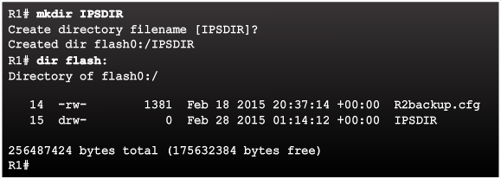
Download the IOS IPS Files
Notes:
5.3.1.2 Download the IOS IPS Files
5.3.1.3 IPS Crypto Key
5.3.1.4 Enable IOS IPS
5.3.1.5 Load the IPS Signature Package in RAM

Slide 34
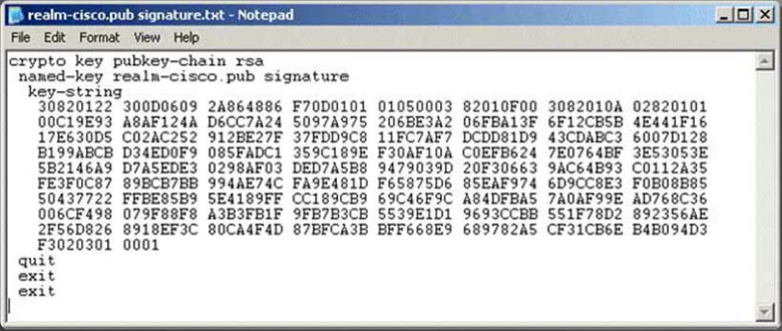
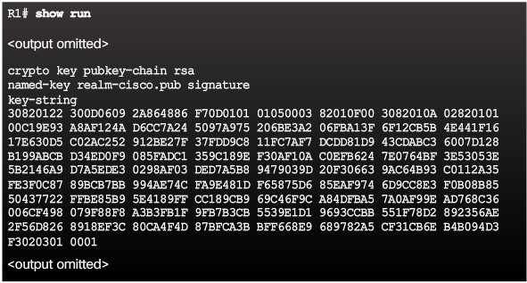
IPS Crypto Key
Notes:
Page 5.3.1.3

Slide 35
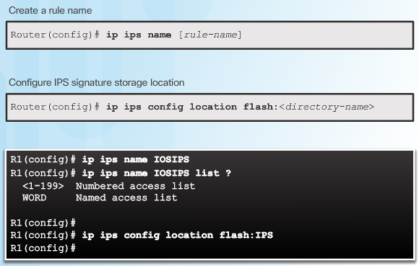
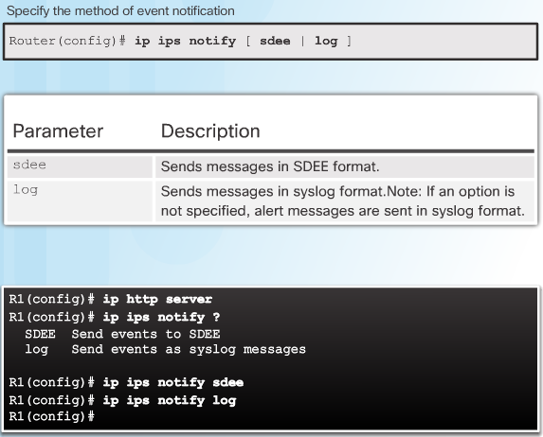
Enable IOS IPS
Flash:IPSDIR
Notes:
Page 5.3.1.4

Slide 36
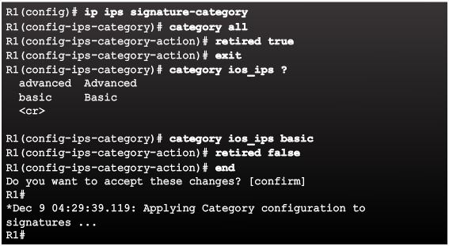
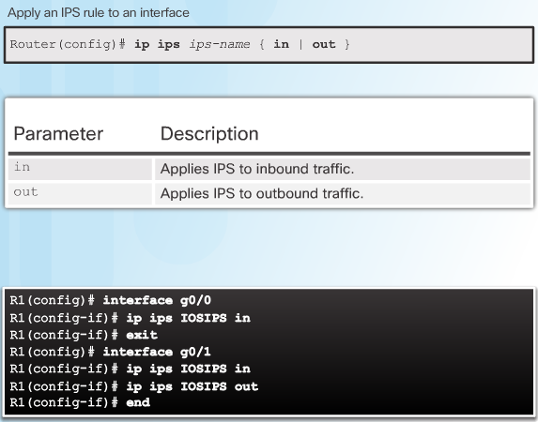
Enable IOS IPS
Notes:
Page 5.3.1.4 (cont.)

Slide 37
Virtual Fragment Reassembly
Virtual Fragment Reassembly (VFR) enables the Cisco IOS Firewall to examine out-of-sequence fragments and reorder the packets into the order. It examines the number of fragments from a same single IP address. When VFR is enabled on a Cisco IOS Firewall, it creates the appropriate dynamic ACLs, thereby protecting the network from various fragmentation attacks. To enable VFR on an interface, use the ip virtual-reassembly command in interface configuration mode, as demonstrated here:
Router(config)# interface Serial0/0/0
Router(config-if)# ip virtual-reassembly
Notes:
http://www.ciscopress.com/articles/article.asp?p=1336425&seqNum=7

Slide 38
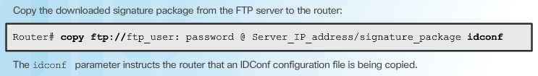
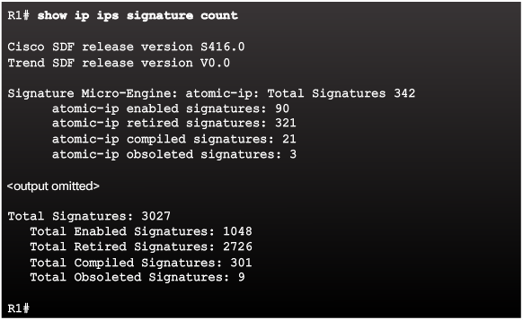
Load the IPS Signature Package in RAM
Notes:
5.3.1.5 Load the IPS Signature Package in RAM (Cont.)
5.3.1.6 Activity – Implementing IPS

Slide 39
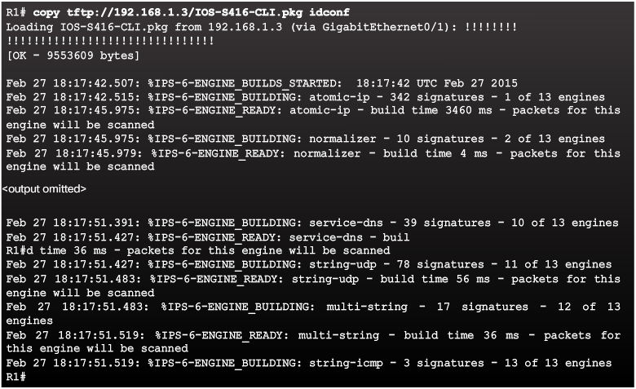
Load the IPS Signature Package in RAM
Notes:
5.3.1.5 Load the IPS Signature Package in RAM

Slide 40
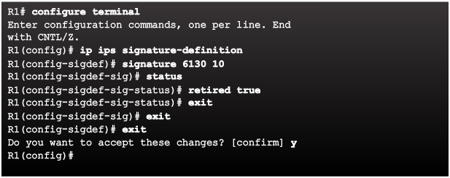
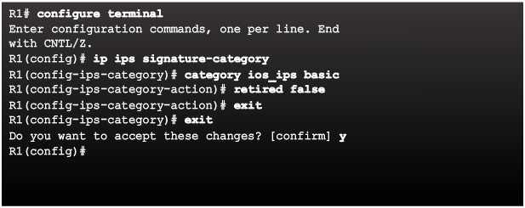
Retire and Unretire Signatures
Retiring an Individual Signature:
Retiring a Signature Category:
Notes:
5.3.2.1 Retire and Unretire Signatures

Slide 41
Topic 5.3.2: Modifying Cisco IOS IPS Signatures

Slide 42
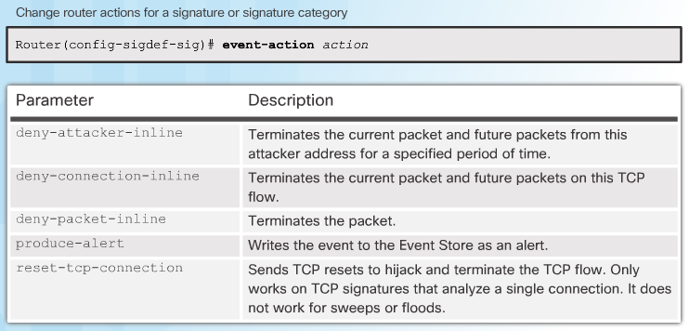
Change Signature Actions
Notes:
5.3.2.2 Change Signature Actions

Slide 43
Topic 5.3.3: Verify and Monitor IPS

Slide 44
Verify IOS IPS
Show commands to verify the IOS IPS configuration:
show ip ips
show ip ips all
show ip ips configuration
show ip ips interfaces
show ip ips signatures
show ip ips statistics
Clear commands to disable IPS:
clear ip ips configuration
clear ip ips statistics
Notes:
5.3.3.1 Verify IOS IPS

Slide 45
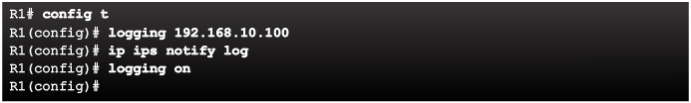
Report IPS Alerts
Notes:
5.3.3.2 Report IPS Alerts

Slide 46
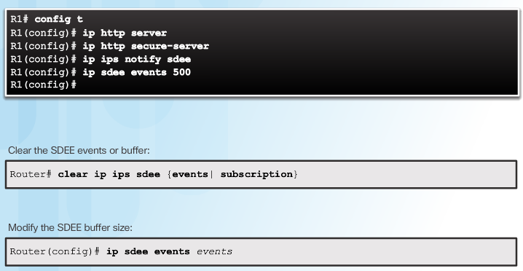
Enable SDEE
SDEE uses a pull mechanism. That is, requests come from the network management application, and the IDS and IPS router responds.
To view SDEE alarm messages in Cisco SDM, choose Monitor > Logging > SDEE Message Log
Notes:
5.3.3.3 Enable SDEE
http://www.ciscopress.com/articles/article.asp?p=1336425&seqNum=7

Slide 47
Section 5.4: Summary
Chapter Objectives:
Describe IPS technologies and how they are implemented.
Explain IPS Signatures.
Describe the IPS implementation process.
Notes:
5.4.1.1 Packet Tracer – Configure an IOS IPS Using CLI
5.4.1.2 Lab – Configure an IOS IPS Using CLI

Slide 49
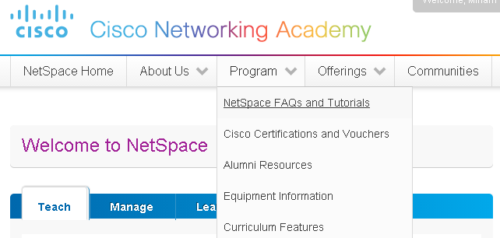
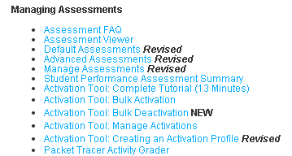
Instructor Resources
Remember, there are helpful tutorials and user guides available via your NetSpace home page. (https://www.netacad.com)
These resources cover a variety of topics including navigation, assessments, and assignments.
A screenshot has been provided here highlighting the tutorials related to activating exams, managing assessments, and creating quizzes.
1
2
Notes:
https://www.netacad.com

